Slide 1

Lesson 2: TRIGONOMETRY OF RIGHT TRIANGLES
Math 12
Plane and Spherical Trigonometry
Notes:
Week 2

Slide 2
OBJECTIVES
At the end of the lesson the students are expected to:
Define the six trigonometric functions as ratios of the sides of a right triangle
Evaluate the trigonometric functions of an angle
Evaluate the trigonometric functions of special angles
Solve right triangles.

Slide 3
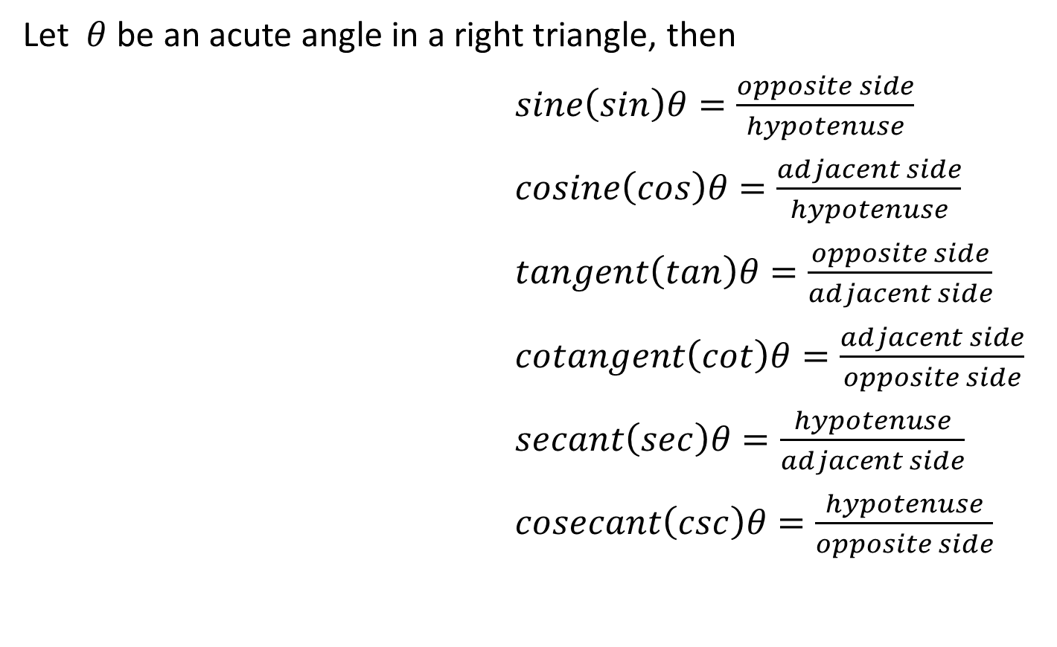
TRIGONOMETRIC FUNCTIONS
Let $θ$ be an acute angle in a right triangle, then
$sine\left(sin\right)θ=\frac{opposite side}{hypotenuse}$
$cosine\left(cos\right)θ=\frac{adjacent side}{hypotenuse}$
$tangent\left(tan\right)θ=\frac{opposite side}{adjacent side}$
$cotangent\left(cot\right)θ=\frac{adjacent side}{opposite side}$
$secant\left(sec\right)θ=\frac{hypotenuse}{adjacent side}$
$cosecant\left(csc\right)θ=\frac{hypotenuse}{opposite side}$
hypotenuse
Opposite
side
Adjacent
side

Slide 4

RECIPROCAL FUNCTIONS
The following gives the reciprocal relations of the six trigonometric functions:
$$\sin{θ}=\frac{1}{\csc{θ}} \csc{θ}=\frac{1}{\sin{θ}}$$
$$\cos{θ}=\frac{1}{\sec{θ}} \sec{θ=\frac{1}{\cos{θ}}}$$
$$\tan{θ}=\frac{1}{\cot{θ}} \cot{θ=\frac{1}{\tan{θ}}}$$

Slide 5

PYTHAGOREAN THEOREM
The Pythagorean Theorem states that the square of the hypotenuse is equal to the sum of the squares of the other two sides. Referring to the right triangle below, then
$${c^{2}=a}^{2}+b^{2}$$
The Pythagorean Theorem
is used to find the side of
a right triangle
B
c
a
A
C
b

Slide 6
FUNCTIONS OF COMPLEMENTARY ANGLES
B
sin A =
sin B =
c
a
cos A =
cos B =
C
A
b
tan A =
tan B =
Comparing the trigonometric functions of the acute angles A and B, and making use of the fact that A and B are complementary angles (A+B=90⁰), then
cot A =
cot B =
sec A =
sec B =
csc A =
csc B =

Slide 7
FUNCTIONS OF COMPLEMENTARY ANGLES
sin B = sin = cos A
cos B = cos = sin A
tan B = tan = cot A
cot B = cot = tan A
sec B = sec = csc A
csc B = csc = sec A
The relations may then be expressed by a single statement that: A trigonometric function of an angle is always equal to the co-function of the complement of the angle.

Slide 8
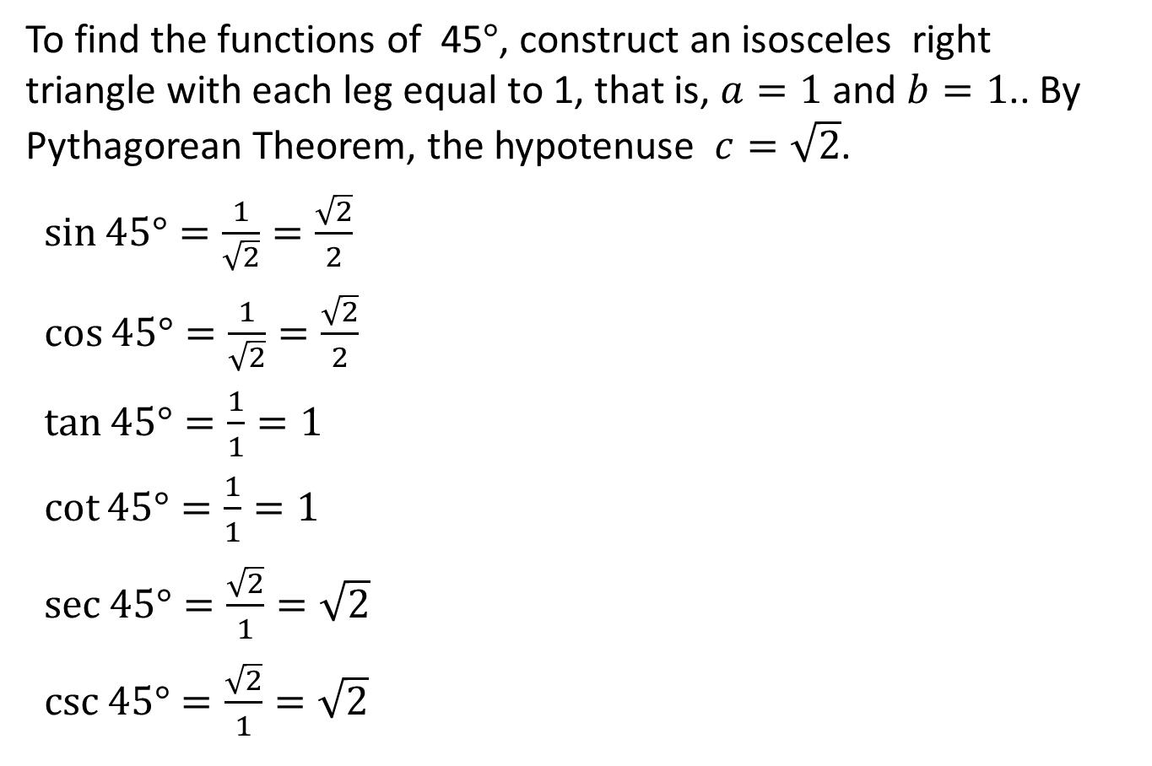
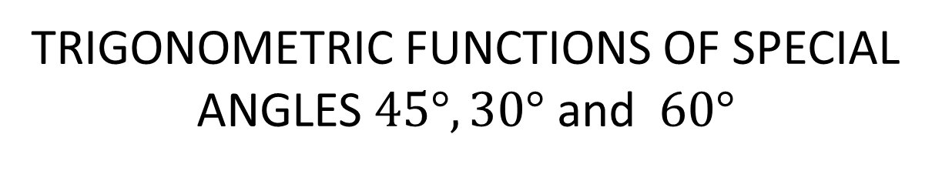
TRIGONOMETRIC FUNCTIONS OF SPECIAL ANGLES $45°, 30°$ and $60°$
To find the functions of 45$°$, construct an isosceles right triangle with each leg equal to 1, that is, $a=1$ and $b=1$.. By Pythagorean Theorem, the hypotenuse $c=\sqrt{2}$.
$\sin{45°=\frac{1}{\sqrt{2}}=\frac{\sqrt{2}}{2}}$
$\cos{45°=\frac{1}{\sqrt{2}}=\frac{\sqrt{2}}{2}}$
$\tan{45°=\frac{1}{1}=1}$
$\cot{45°=\frac{1}{1}=1}$
$\sec{45°=\frac{\sqrt{2}}{1}=\sqrt{2}}$
$\csc{45°=\frac{\sqrt{2}}{1}=\sqrt{2}}$
45⁰
1
45⁰
1

Slide 9

To find the functions of 30⁰ and 60⁰, take an equilateral triangle of side 2 and draw the bisector of one of the angles. This bisector divides the equilateral triangle into two congruent right triangles whose angles are 30⁰ and 60⁰. By Pythagorean Theorem the length of the altitude is $\sqrt{3}$ .
30⁰
2
60⁰
1

Slide 10
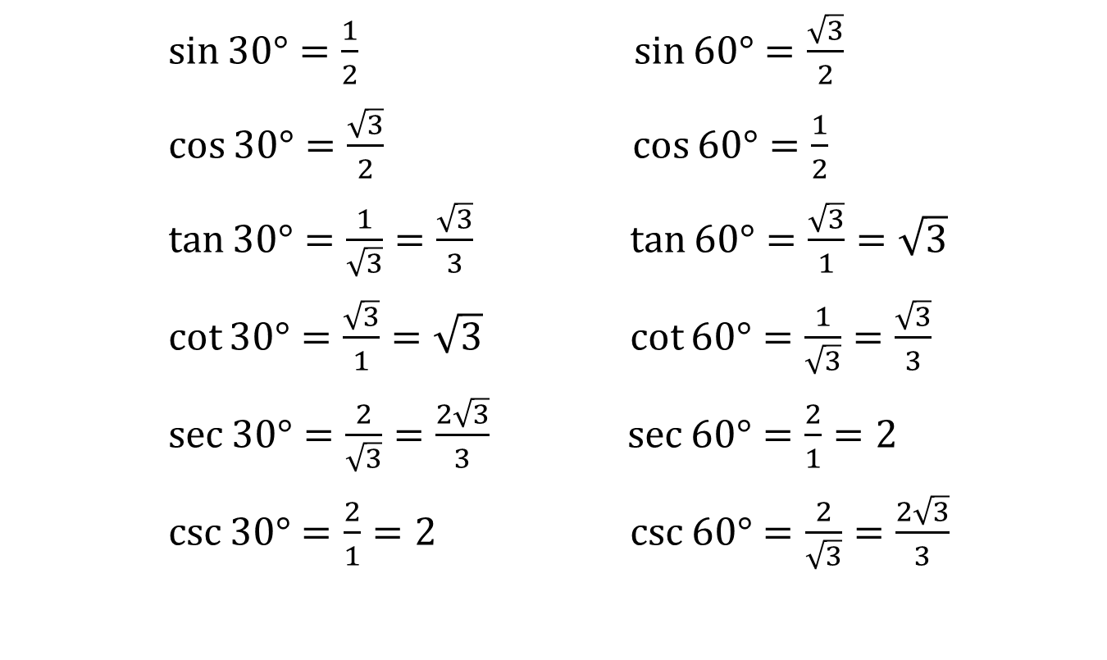
$\sin{30°=\frac{1}{2}}$ $\sin{60°=\frac{\sqrt{3}}{2}}$
$\cos{30°=\frac{\sqrt{3}}{2}}$ $\cos{60°=\frac{1}{2}}$
$\tan{30°=\frac{1}{\sqrt{3}}=\frac{\sqrt{3}}{3}}$ $\tan{60°=\frac{\sqrt{3}}{1}=\sqrt{3}}$
$\cot{30°=\frac{\sqrt{3}}{1}=\sqrt{3}}$ $\cot{60°=\frac{1}{\sqrt{3}}=\frac{\sqrt{3}}{3}}$
$\sec{30°=\frac{2}{\sqrt{3}}=\frac{2\sqrt{3}}{3}}$ $\sec{60°=\frac{2}{1}=2}$
$\csc{30°=\frac{2}{1}=2}$ $\csc{60°=\frac{2}{\sqrt{3}}=\frac{2\sqrt{3}}{3}}$

Slide 11
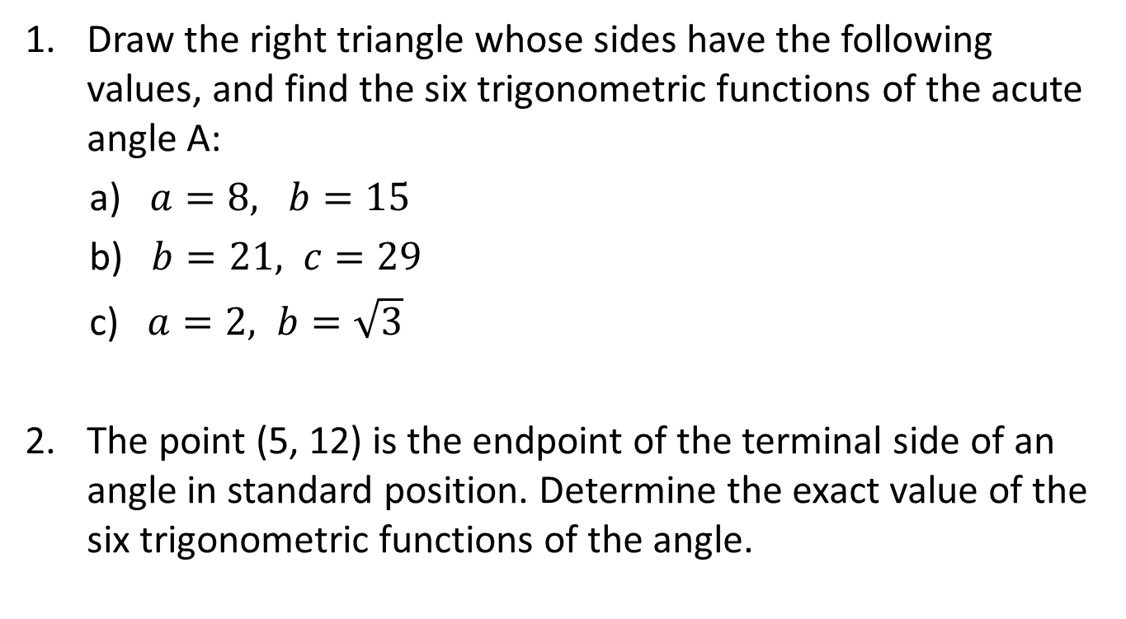
EXAMPLES
Draw the right triangle whose sides have the following values, and find the six trigonometric functions of the acute angle A:
a) $a=8, b=15$
b) $b=21, c=29$
c) $a=2, b=\sqrt{3}$
The point (5, 12) is the endpoint of the terminal side of an angle in standard position. Determine the exact value of the six trigonometric functions of the angle.

Slide 12
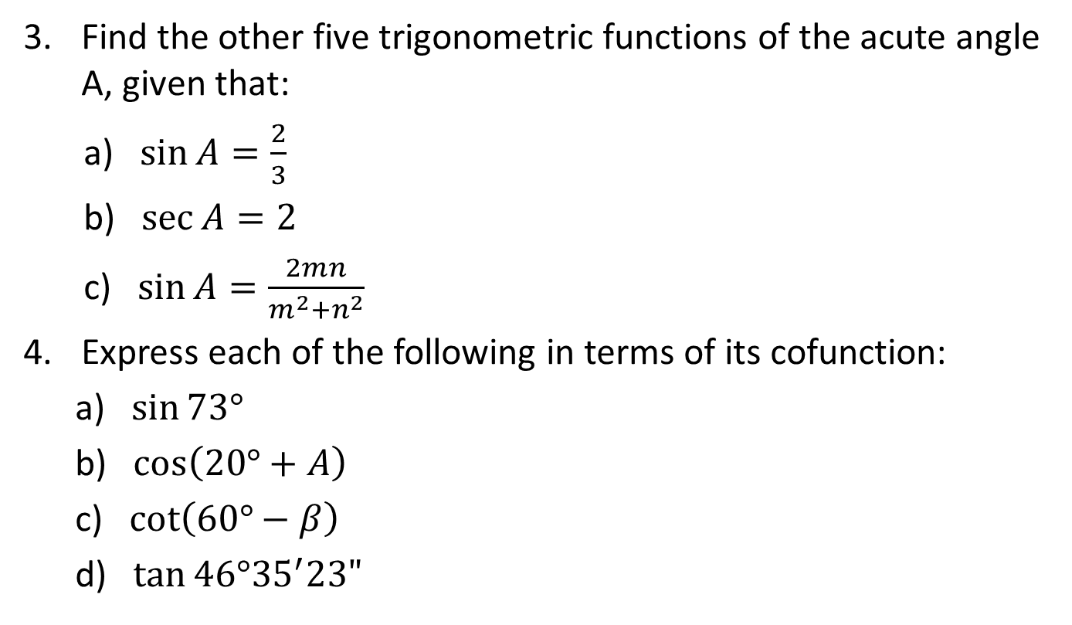
EXAMPLES
Find the other five trigonometric functions of the acute angle A, given that:
a) $\sin{A=\frac{2}{3}}$
b) $\sec{A=2}$
c) $\sin{A=\frac{2mn}{m^{2}+n^{2}}}$
Express each of the following in terms of its cofunction:
a) $\sin{73°}$
b) $\cos\left(20°+A\right)$
c) $\cot\left(60°−β\right)$
d) $\tan{46°{35}^{′}23"}$

Slide 13
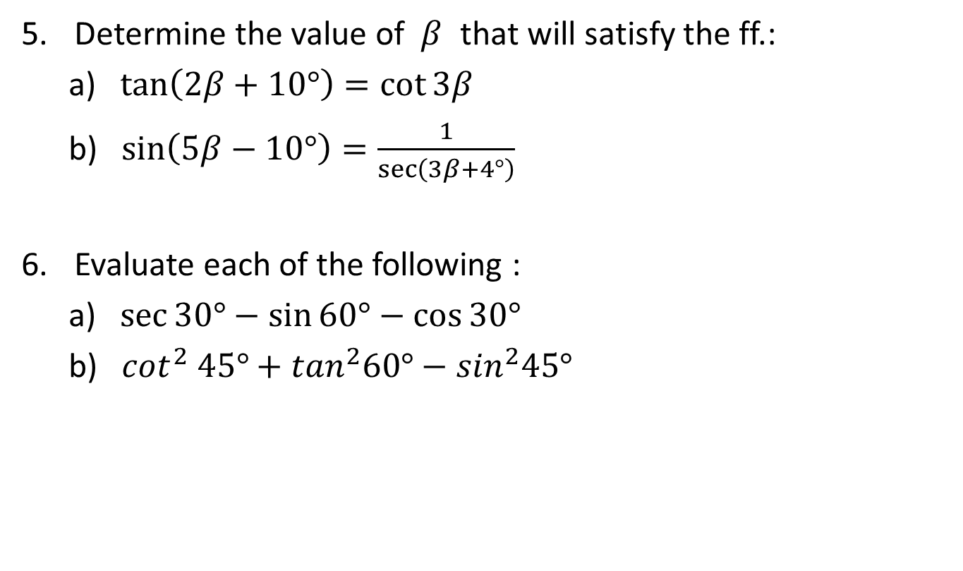
EXAMPLES
Determine the value of $β$ that will satisfy the ff.:
a) $\tan\left(2β+10°\right)=\cot{3β}$
b) $\sin\left(5β−10°\right)=\frac{1}{\sec\left(3β+4°\right)}$
Evaluate each of the following :
a) $\sec{30°−\sin{60°−\cos{30°}}}$
b) $\cot^{2} 45°+\tan^{2}60°−\sin^{2}45°$

